Slide 1
Real Time Drowsiness Detector
&
CNN Based Risk Prediction

Slide 2
In the year 2009, the US National Sleep Foundation (NSF) reported that 54% of adult drivers have driven a vehicle while feeling drowsy and 28% of them actually fell asleep.
The German Road Safety Council (DVR) claims that one in four highway traffic fatalities are a result of momentary driver drowsiness.
According to available statistical data, over 1.3 million people die each year on the road and 20 to 50 million people suffer non-fatal injuries due to road accidents.
The US National Highway Traffic Safety Administration (NHTSA) conservatively estimated that a total of 100,000 vehicle crashes each year are the direct result of driver drowsiness.
These crashes resulted in approximately 1,550 deaths, 71,000 injuries and $12.5 billion in monetary losses

Slide 3
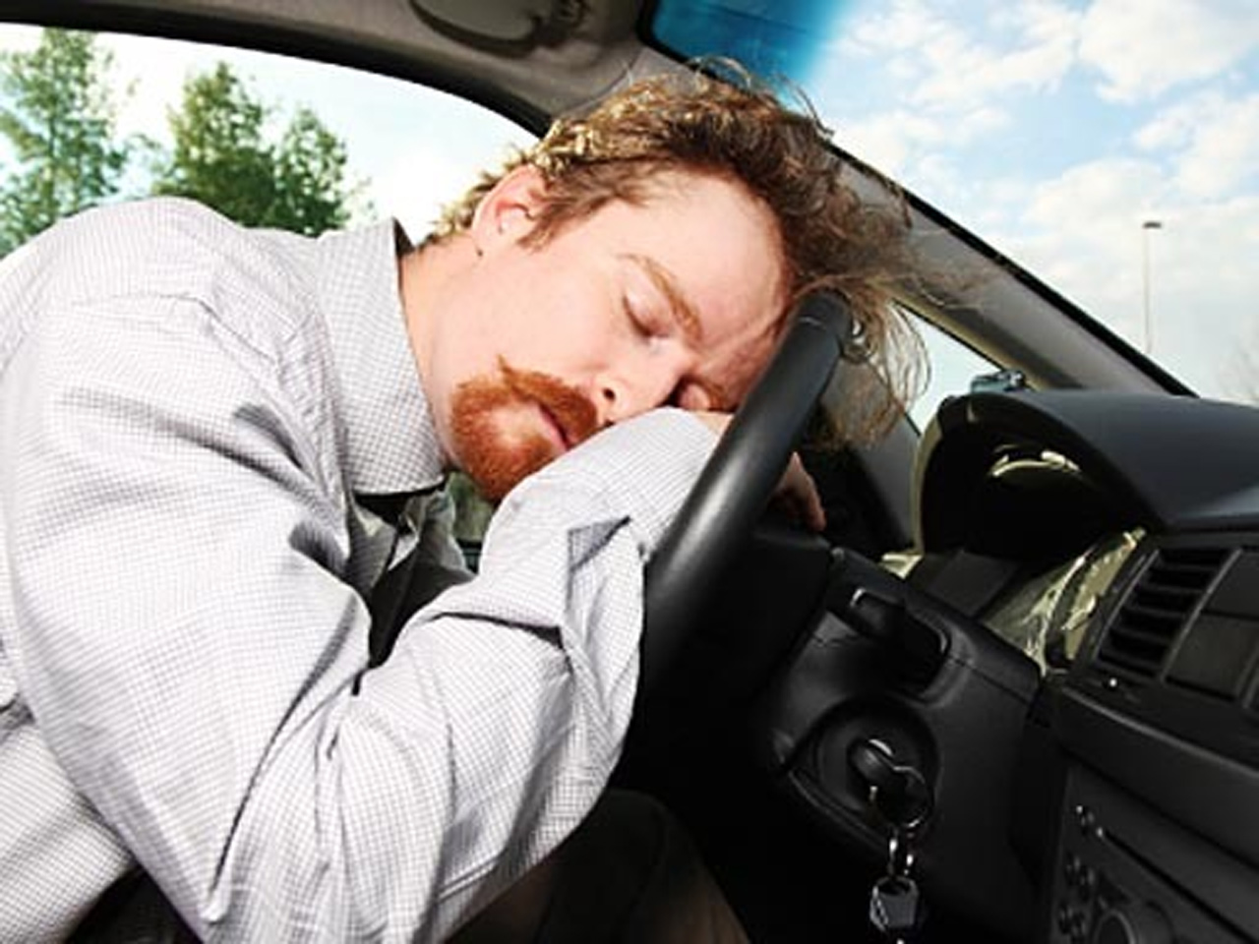
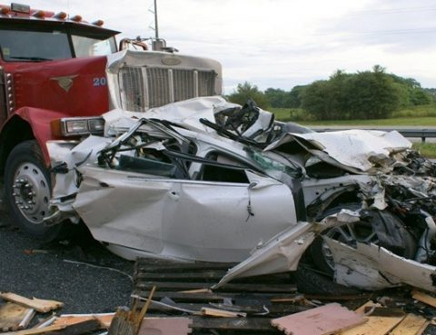
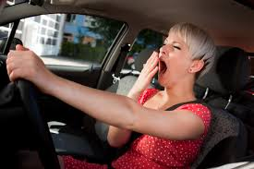

Slide 4
How to prevent road accidents ?
Is there a way we can reduce the number of accidents?
Can there be a mechanism to stay the driver alert ?
→ The awnser is Yes,

Slide 5
Drowsiness Detector
A drowsiness detector tries to detect srowsy state of driver and waje him up as soon as it identifies him asleep
Our project has 3 components :
Old MATLAB based model
Model based on Computer Vision and machine learning
CNN based risk detector

Slide 6
MATLAB BASED MODEL
Initially a camera acquires the video of the driver. Then this video is broken down into frames. After frames are acquired following methods are used
Face Detection
The face detection is done by Viola Jones method. The main aim of face detection is to minimize the false detections in identifying facial expressions.
Eye Tracking
The most important factor which helps detect driver fatigue is the state of eyes, i.e. open or closed. In the state of drowsiness, the eyelid muscles subconsciously gravitate to accelerate the process of going to sleep.
Drowsiness Detection
Once the eyes of Automobile driver are detected, the drowsiness detection function detects whether the driver is drowsy or not, by taking into consideration whether the eyes are open or closed that is the state of the eyes.

Slide 7
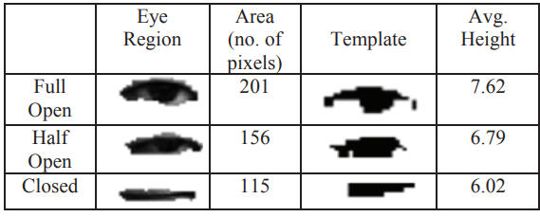
Eye template information

Slide 8
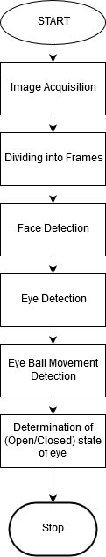

Slide 9
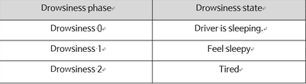
2) Computer vision based model
It is also a real time model where image of driver is fetched using camera(open cv) and using KNN algorithm driver is classified as drowsy or not drowsy.
We calculate EAR(Estimated Average Requirement) value for open as well as closed eye and discover drowsiness level as:

Slide 10
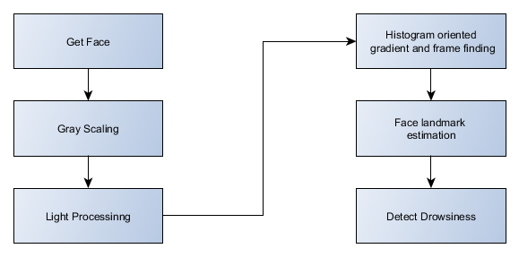
Process:

Slide 11
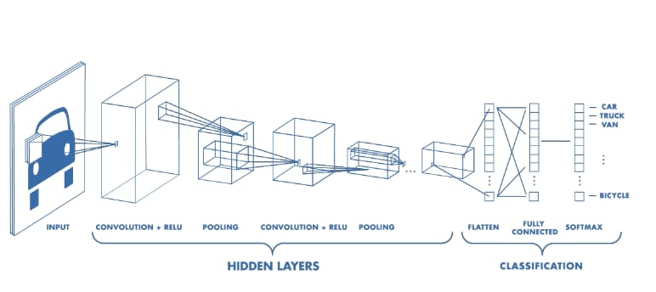
3) CNN based model
What is CNN and how it works?

Slide 13
The image is classified into one of these mentioned below
c0: safe driving
c1: texting - right
c2: talking on the phone - right
c3: texting - left
c4: talking on the phone - left
c5: operating the radio
c6: drinking
c7: reaching behind
c8: hair and makeup
c9: talking to passenger

Slide 14
Result and future outcome
So, as shown above, all the 3 models are just working fine but due to lag of system requirements the appropriate processing speed is not matched but still comparisons have to be made between the MATLAB and SVM based Computer Vision model so as to differentiate between their efficiency and accuracy.
At the same time CNN based classifier model can be used in parller with any of the above in synchronization and it too needs to be trained more for better response.

